Slide 1
Studio Workshop C
Week 05

Slide 2
FPS Game Part 1
What makes a good game?
01
02
03
04
05
06
07
08
09
10
11
12
Level Design & Art Direction
FPS Game
Platformer Game

Slide 3
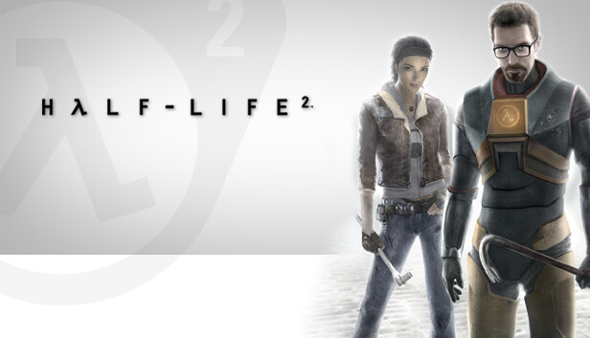
Overview of today
Revision
Assessment 2 Brief
Genre Analysis
FPS Shooters
Programming Functionality
Coding/Logic introduction
Unreal Activities
Introduction to Blueprints
Target Practice Game
Homework
Expand upon your game
Figure 1: Half Life 2 Splash
Note. Developed by Valve Software (2004)

Slide 4
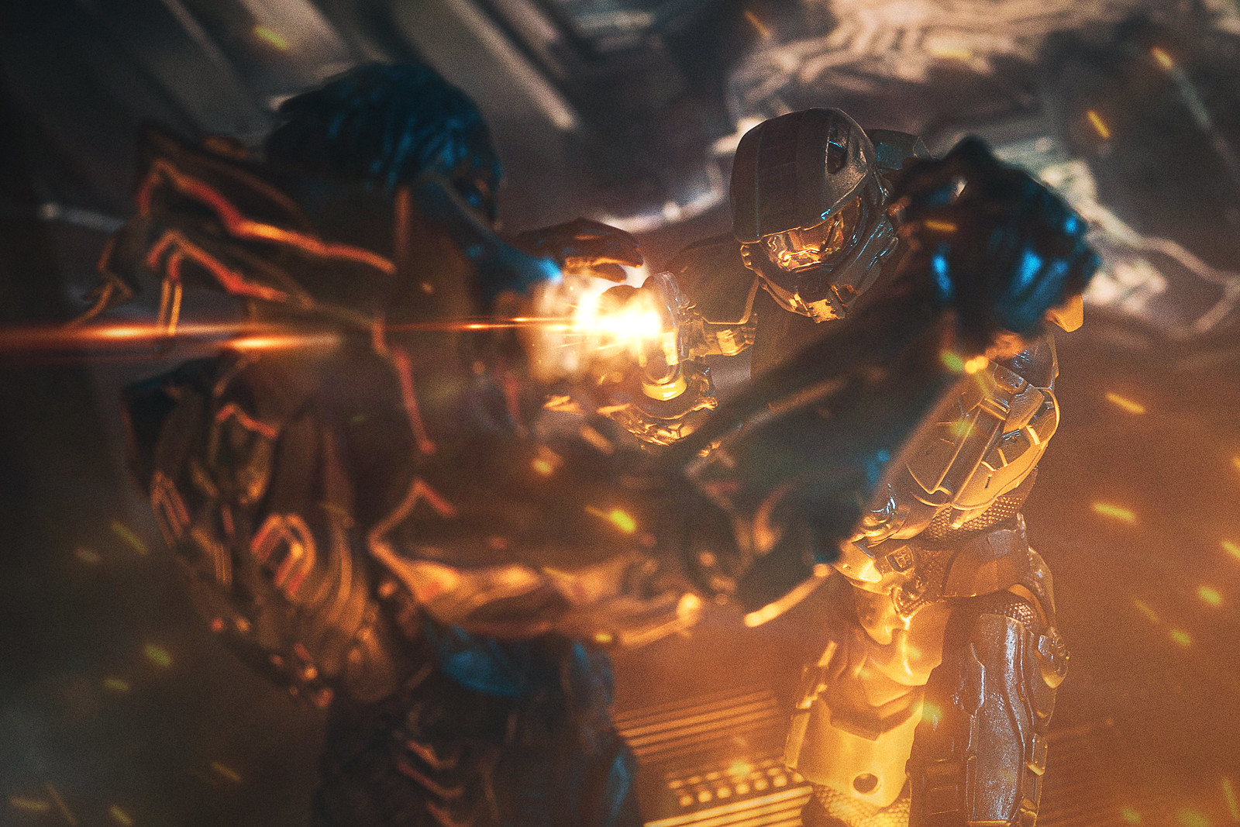
Revision
QUESTIONS
What light type do we generally use to represent the sun?
What scale does Light Temperature use?
How do we apply Post-Processing to just a specific section of a level?
Name three different Post-Processing effects.
Why should we use cool lights in our bedroom?
Figure 2: Halo Action Figure Shot with Bloom
Note. Developed by Bungie (2004)
https://www.reddit.com/r/HaloActionFigures/comments/wzzeyv/reclaimer/

Slide 5
Revision
QUESTIONS
What light type do we generally use to represent the sun?
What scale does Light Temperature use?
How do we apply Post-Processing to just a specific section of a level?
Name three different Post-Processing effects.
Why should we use cool lights in our bedroom?
ANSWERS
A Directional light.
Kelvins (The lower the value, the warmer the colour)
Scale the Post Processing Volume to appropriately cover the area.
Bloom, Noise, Lens Distortion, Chromatic Aberration, Depth of Field, Lens Flares, etc.
You should NEVER use cool lights in a room you are meant to relax in.

Slide 6
Assessment 2 Brief
Due: Week 08, Sunday 23:59:59
Weighting: 40%
Description:
Build a FPS game with two levels accommodating multiple gameplay styles
Create an appropriately styled UI to compliment the game.
Learning Outcomes:
In this assessment, you will demonstrate your ability to replicate and refine gameplay mechanics taught in class using Unreal Engine.
This exercise will help you build a deeper understanding of game mechanics and reinforce your technical skills, rather than on the creative/visual side of things.
You are expected to document and showcase your mechanics, as well as any improvements or refinements you have made, and justify how they work in the context of your game.
For full details, see the Assessment 2 Brief and Checklist document.

Slide 7

Genre Analysis
FPS Games

Slide 8
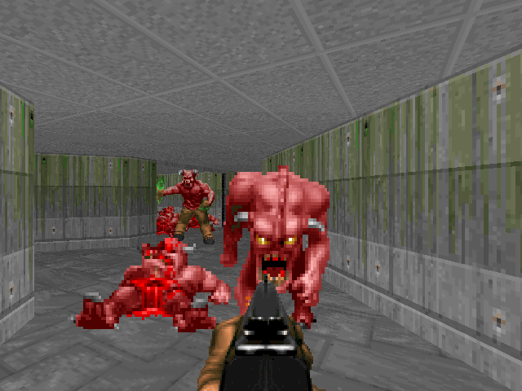
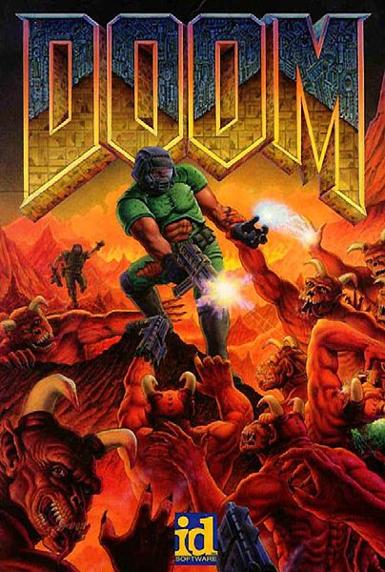
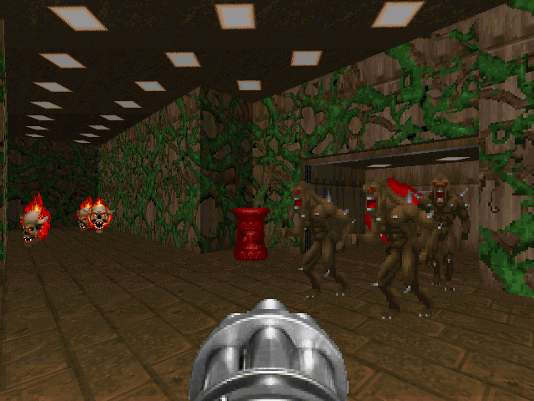
Doom (1993)
The impact of Doom cannot be understated.
Was the fourth FPS game made by id Software.
Hovertank 3D, Catacomb 3D, Wolfenstein 3D.
One of the first licensable Game Engines.
Blood, Hexen, Heretic and more.
Openly encouraged modding.
Ran at a blistering 60 fps @ 640x480px.
Multiplayer across LAN or 'The Internet'
Required a massive 4 floppy disks to install (1.44Mb each!)
Essentially created the genre - all other FPS games that came after were referred to as Doom Clones.
Figure 4: Doom Final Ambush Level
Figure 3: Doom PC Cover
Note. Developed and published by id Software (1993)
Figure 5: Doom Halls of the Damned Level
Note. Developed and published by id Software (1993)
Note. Developed and published by id Software (1993)
Notes:
Made by a team of 5 people. Distributed through shareware (first part of the game given for free, the rest you would mail in money and get sent the rest on disks).
At the forefront on the internet in terms of distribution.

Slide 9
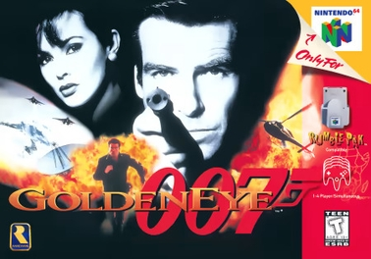
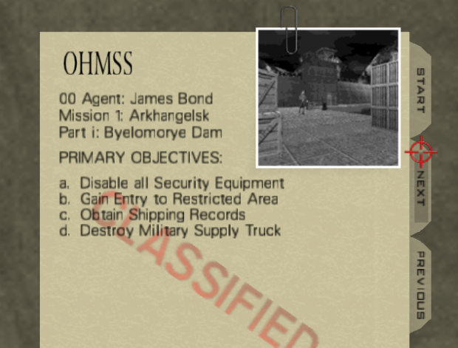
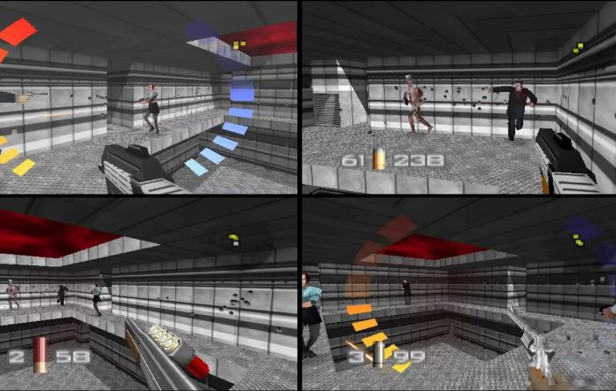
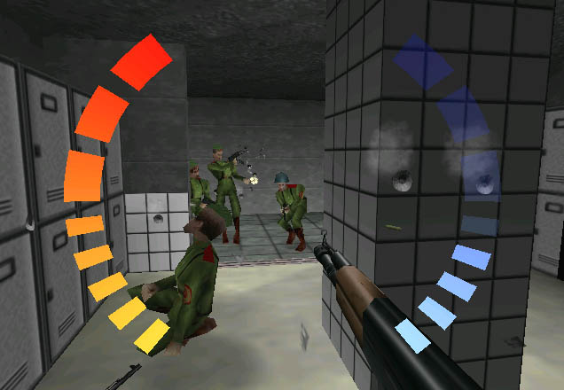
Goldeneye (1997)
Proving that consoles could do the genre, Goldeneye on the Nintendo 64 was a runaway success and became the blueprint for how the genre could work on consoles.
Accurate to the film single player campaign.
Controller throwing 4-player multiplayer mode.
Constantly at the top of 'Best N64 Games' lists.
Won a BAFTA Award for Best Computer Game in 1998.
Inducted into the World Video Game Hall of Fame in 2025.
"No Oddjobs!"
Winner of Petr Joura’s ‘Worst Game of 1997’ award, but Brendan's 'Best Game of 1997’
Brendan doesn’t know what he’s talking about
Figure 6: Goldeneye 007 N64 Cover
Figure 7: Goldeneye 007 Mission Briefing Screen
Note. Developed by Rare Software, published by Nintendo (1997).
Note. Developed by Rare Software, published by Nintendo (1997).
Figure 8: Goldeneye 007 Multiplayer
Figure 9: Goldeneye 007 Gameplay
Note. Developed by Rare Software, published by Nintendo (1997).
Note. Developed by Rare Software, published by Nintendo (1997).
Notes:
No Oddjobs – Oddjob was the shortest character in the game and unfair to play against as he had half the hitbox leading to many frustrations and banning from most multiplayer games.

Slide 10
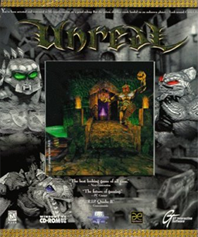
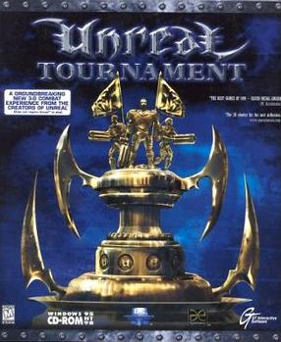
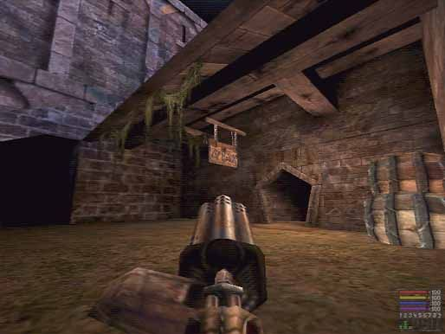
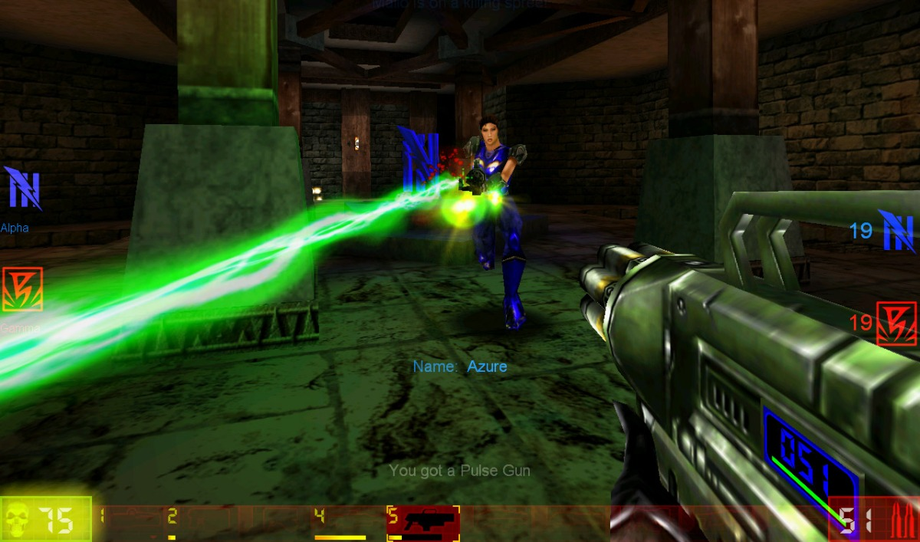
Unreal (1998) & Unreal Tournament (1999)
Figure 10: Unreal PC Cover
Figure 11: Unreal Tournament PC Cover
Not the first fully 3D FPS (that was Quake), but groundbreaking for several reasons:
First use of the Unreal Engine
Optimized for highest quality graphics
Creation of UnrealScript as a scripting language
Unreal Tournament had a pure focus on multiplayer.
Optimized engine allowed for immersive and experimental level designs. Set the groundwork for modern design conventions.
Note. Developed by Epic MegaGames and Digital Extremes, published by GT Interactive (1998).
Note. Developed by Epic MegaGames and Digital Extremes,published by GT Interactive (1999).
Figure 12: Unreal Gameplay
Figure 13: Unreal Tournament Gameplay
Note. Developed by Epic MegaGames and Digital Extremes, published by GT Interactive (1999).
Note. Developed by Epic MegaGames and Digital Extremes, published by GT Interactive (1998).
Notes:
Unlike other 3D FPS games where you placed blocks into empty space, in Unreal 1 to 3 you started with a solid world that you hollowed rooms out of.

Slide 11
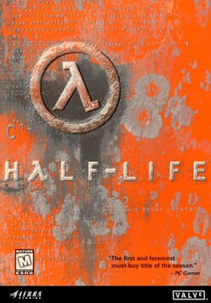
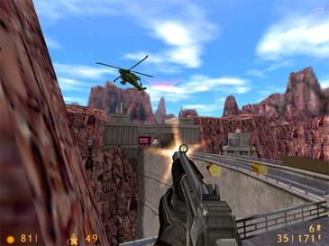
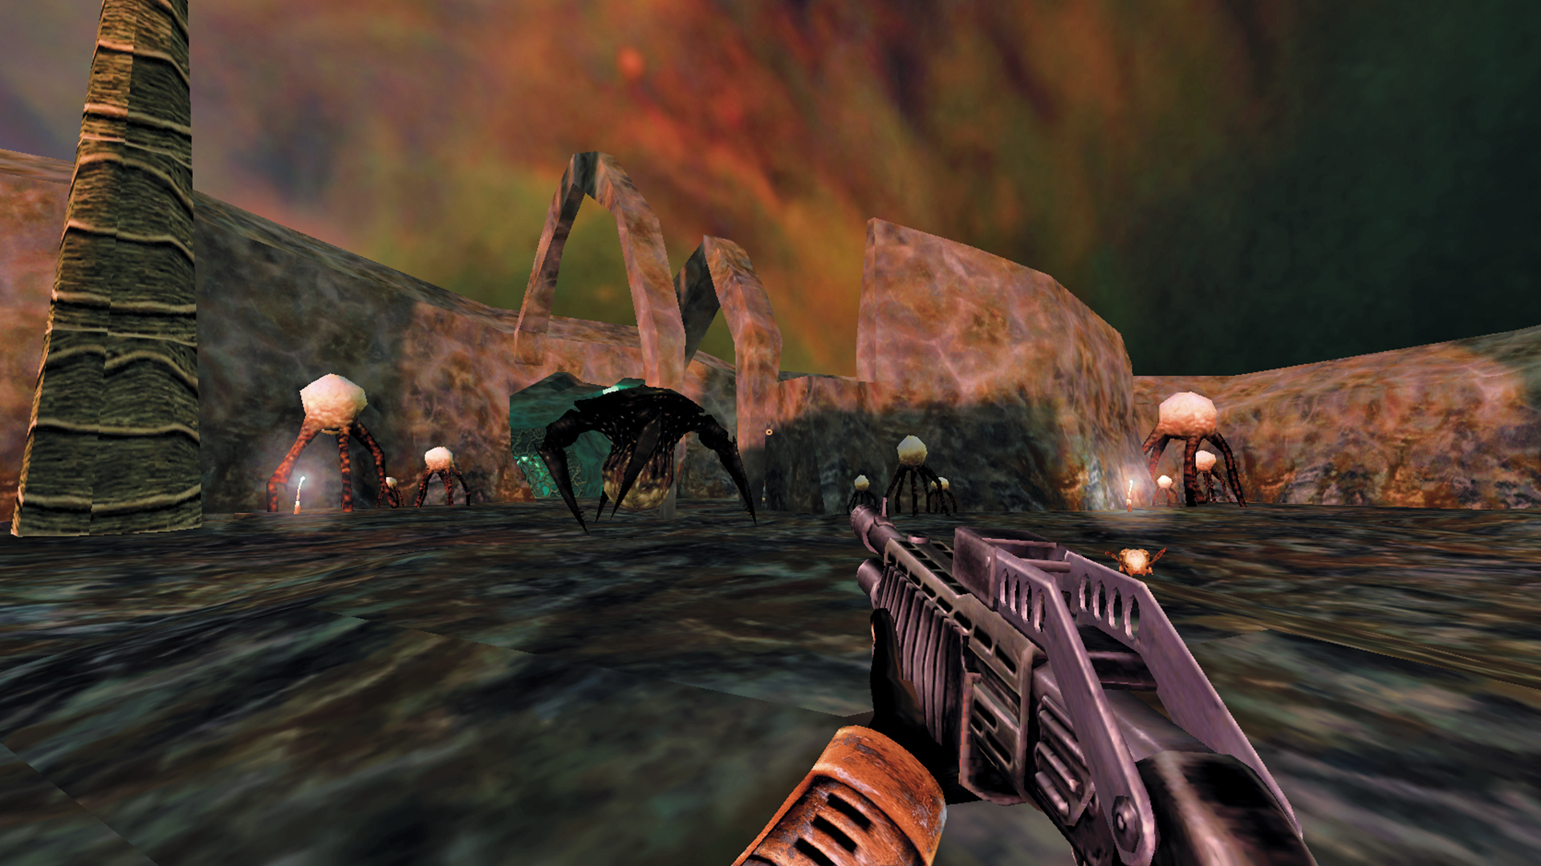
Half Life (1998)
Heavy focus on narrative, with the removal of cut scenes (due to budget) in favour of in-game story telling.
Received acclaim for its graphics, gameplay and narrative and won more than 50 PC "Game of the Year" awards.
It is considered one of the most influential first-person shooter games.
Inspired numerous fan-made mods, some of which became standalone games, such as
Counter-Strike
Day of Defeat
Team Fortress Classic
Led to the creation of the Source engine.
Figure 14: Half Life PC Cover
Figure 15: Half Life gameplay
Note. Developed by Valve Corporation, published by Sierra Studios (1998).
Figure 16: Half Life gameplay
Note. Developed by Valve Corporation, published by Sierra Studios (1998).
Note. Developed by Valve Corporation, published by Sierra Studios (1998).

Slide 12
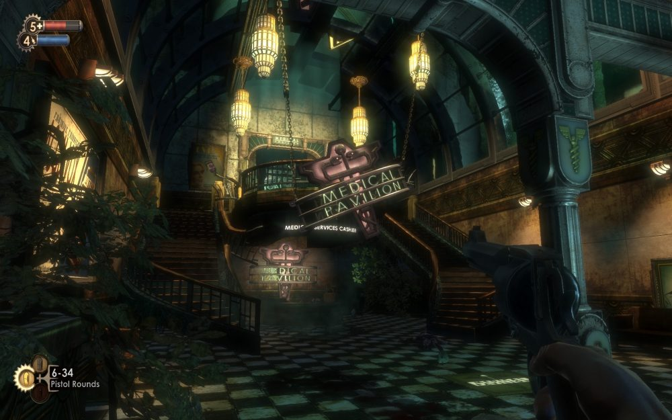

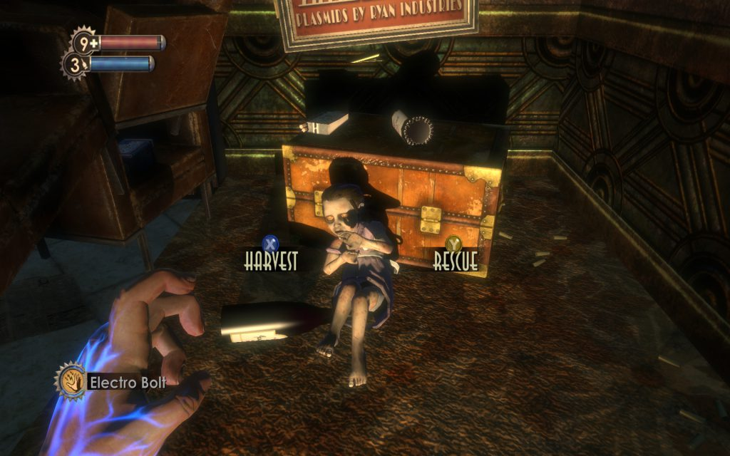
Bioshock (2007)
Petr Joura’s love child.
Incorporated many RPG style systems.
Story focused design.
Moral choices incorporated into gameplay.
Brought the ‘immersive sim’ subgenre mainstream.
Opened up public discourse on whether games can be considered art.
QUESTION: What games do you consider art and why?
Figure 18: Bioshock opening level gameplay
Figure 17: Bioshock PC Cover
Note. Developed by 2K Boston and 2K Australia, published by 2K Games (2007).
Figure 19: Bioshock opening level gameplay
Note. Developed by 2K Boston and 2K Australia, published by 2K Games (2007)
Note. Developed by 2K Boston and 2K Australia, published by 2K Games (2007).
Notes:
What games might studnets consider to be

Slide 13
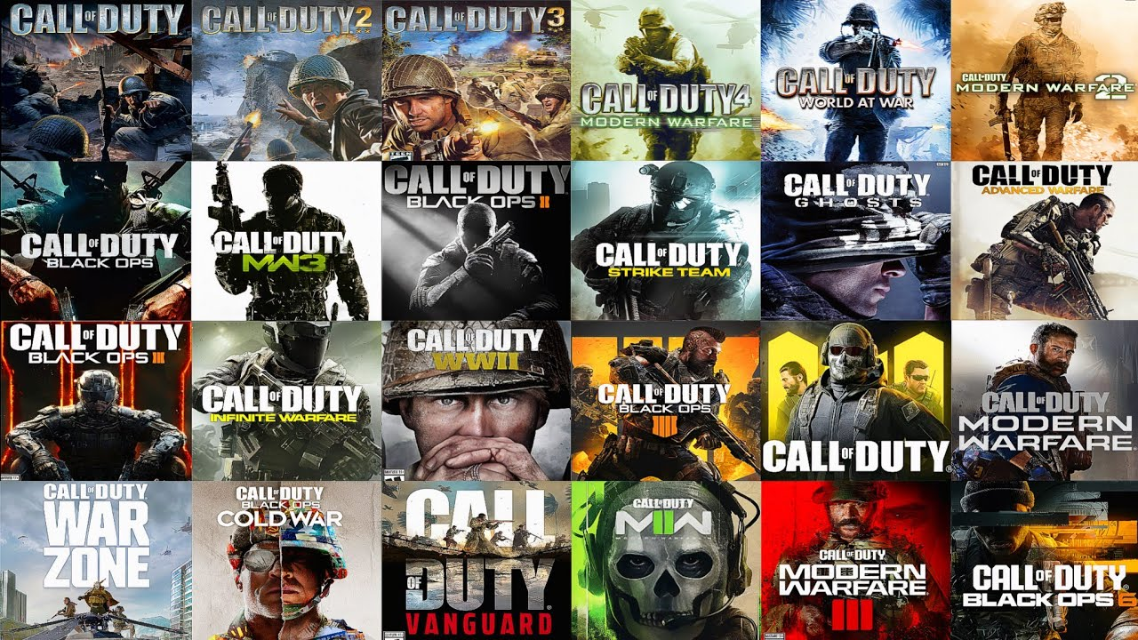
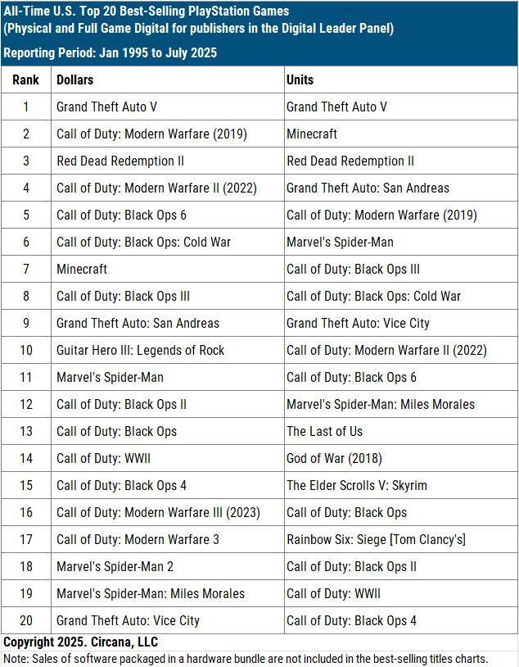
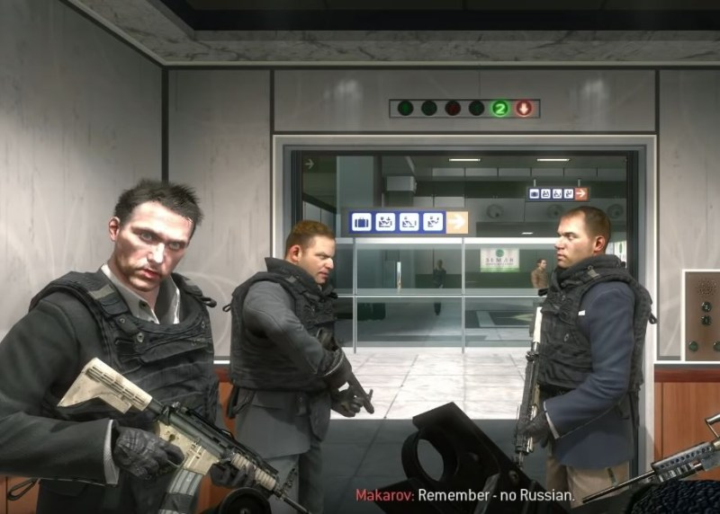
Call of Duty (2003 – the end of time)
Figure 20: Call of Duty PC Covers
Figure 22: PlayStation All Time Sales Chart
Like it or hate it, there's no denying the impact of Call of Duty on the genre.
Annualised the genre.
Usually the realm of sports games
Constantly the best-selling game of the year.
Had some controversial moments that made it to the mass-media.
Commonly associated with producing toxic culture in games.
Note. Developed by various, published by Activision (2003 – 2025).
Figure 21: Call of Duty: Modern Warfare II 'No Russians' mission
Note. Developed by Infinity Ward, published by Activision (2009).
Notes:
No Russians outcry as you played a terrorist that had to shoot and kill innocents.
While not the only game community involved, there were a lot who participated in Gamergate.
Gamergate - Wikipedia

Slide 14
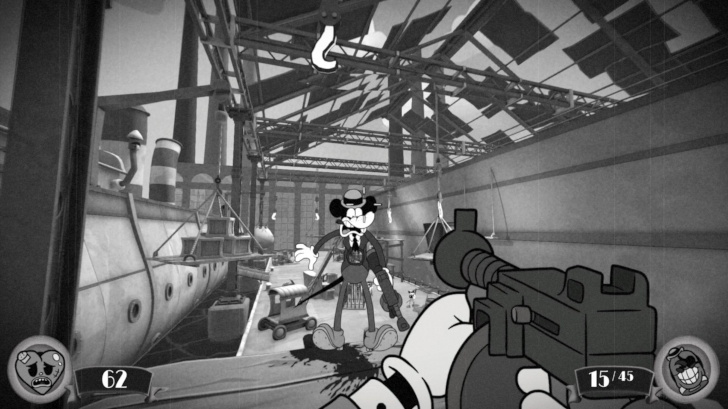
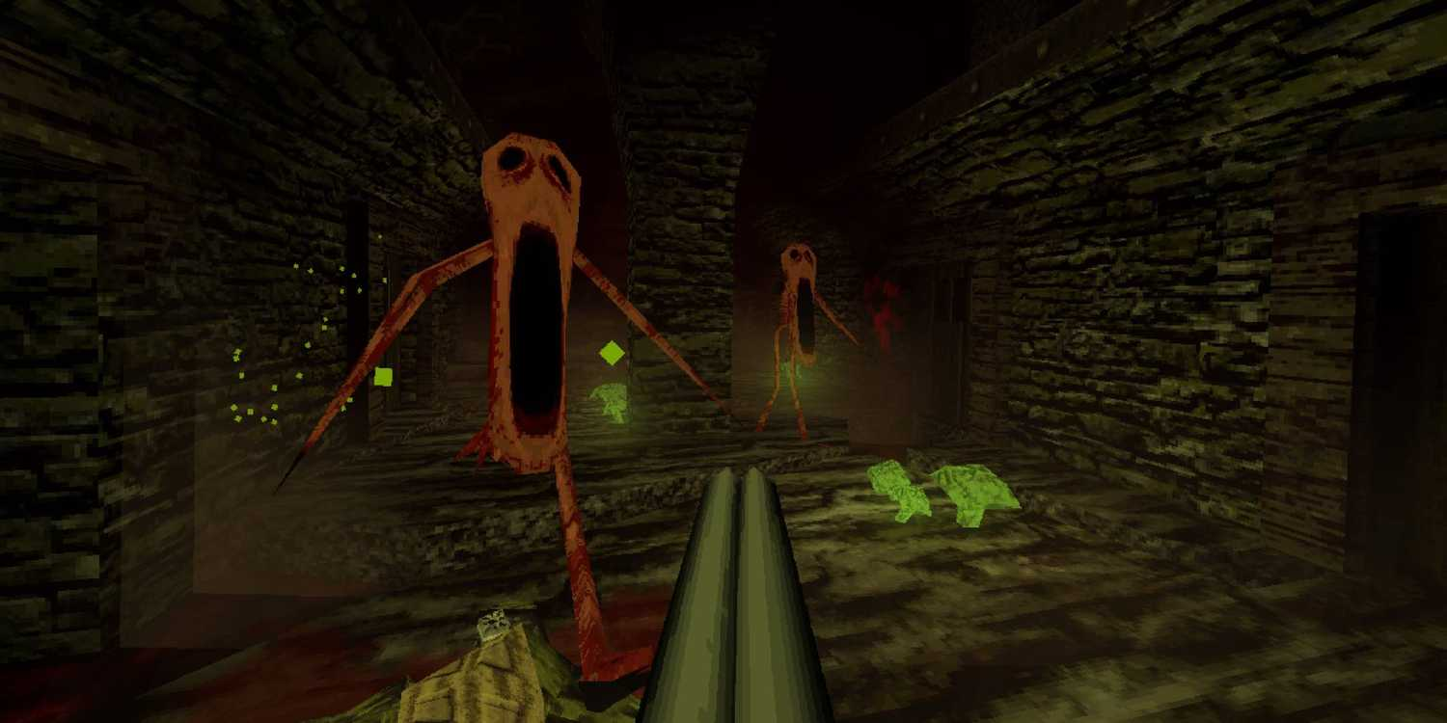
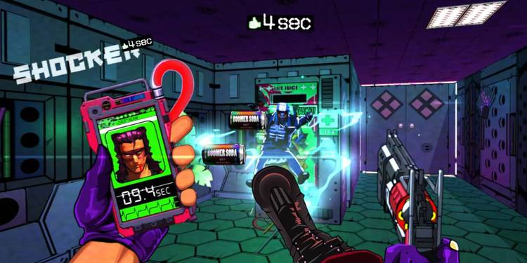
Indie FPS
Mouse PI for Hire
Fumi Games
DUSK
David Szymanski
Mullet Madjack
Hammer 95
Figure 23: Mouse PI for Hire gameplay
Figure 24: Dusk gameplay
Figure 25: Mullet Madjack gameplay
Note. Developed by Fumi Games, published by Playside Studios (2025).
Note. Developed by David Szymanski, published by New Blood Interactive (2018).
Note. Developed by Hammer 52, published by Epopeia Games (2024).
Charm of hand-drawn rubber hose animation inspired by the classic cartoons of the 1930’s.
DUSK is a more horror-focused FPS that takes a lot of inspiration from classic 90s boomer shooters.
Mullet MadJack is an incredibly frantic and frenetic first-person shooter.
Notes:
Mullet MadJack is a very unique FPS game in terms of both its aesthetic and its gameplay mechanics. Taking clear inspiration from 90s anime, Mullet MadJack is an incredibly frantic and frenetic first-person shooter that sees players attempt to increase their time limit by killing enemies. Starting with just 10 seconds, fans must systematically eliminate every enemy they see without getting distracted, or they risk losing everything.
10 Best Indie FPS Games

Slide 15
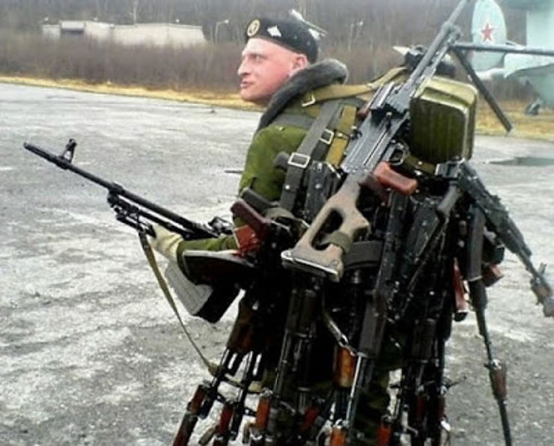
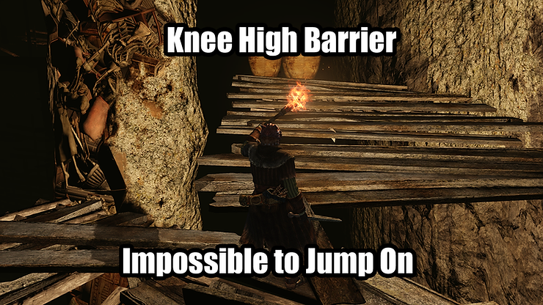
FPS Game Tropes
Discussion
What are some of the tropes of FPS games?
What do you like about the genre?
What do you dislike about the genre?
Figure 27: Soldier carrying many guns
Figure 26: Kne high barrier meme
Figure 27.Soldier carrying a lot of guns
Note. From Nomads Review (2020). https://www.nomadsreviews.co.uk/post/top-eight-fps-tropes-that-hilariously-make-no-sense
Figure 26.Knee High Barrier Meme
Note. From Nomads Review (2020). https://www.nomadsreviews.co.uk/post/top-eight-fps-tropes-that-hilariously-make-no-sense
Notes:
Unlimited Ammo, Can carry infinite amount of weapons,

Slide 16
Coding Introduction
How do games work under the hood?

Slide 17
Coding Introduction
Variables

Slide 18
Variables
What are variables?
Where have you seen or heard the term used in the real world?
Think of some real-world examples and the types of information they contain.

Slide 19
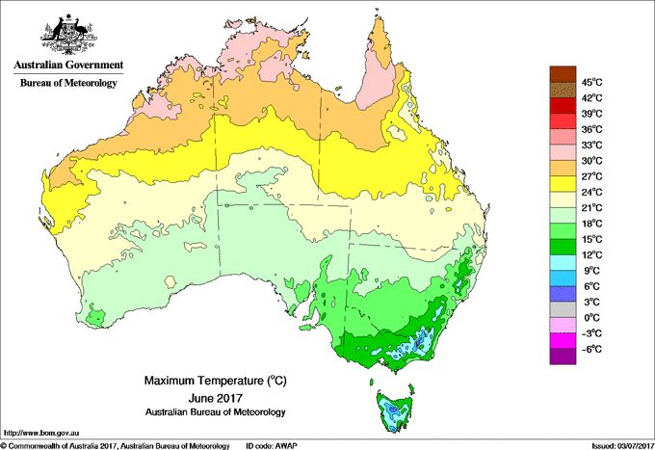


Variable examples in the real world
Variable weather systems
Variable speed limits
Your age

Slide 20

Variable exercise
What variables does a cat have?
Notes:
Open notepad and enter these into a doc for them to see how they get written.
Variable Format:
Scope dataType variableName = value;

Slide 21
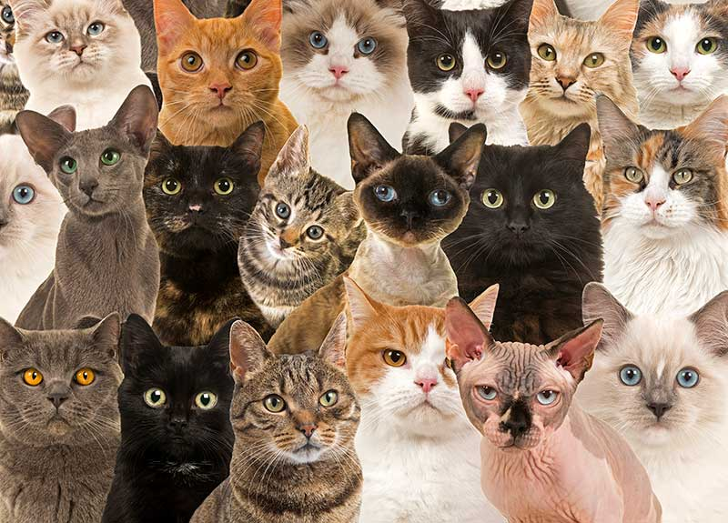
Variable exercise
What variables does a cat have?
Breed
Fur Colour
Eye Colour
Vocal Pitch
Fur Length
Whisker Length
Age
Weight
Gender
Name
Etc...
Figure 1.Picture of many cats
Note. From Do cats listen to people,(2020), Brittania School. https://news.eb.com/level2/cats-listen/

Slide 22
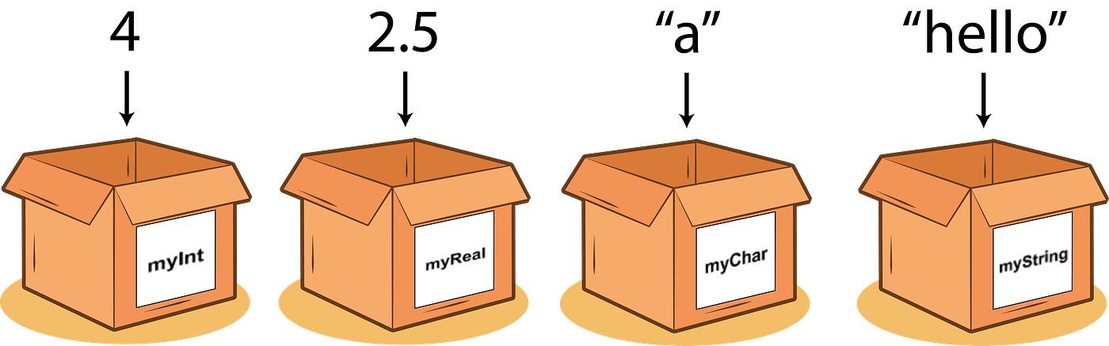
Variables in programming
A variable in programming is a named storage location that holds a value or data.
These values can change during the execution of a program, hence the term "variable."
Variables are essential for storing and manipulating data in computer programs.
Think of them like a box that stores information of a particular type.
We give a variable a name, then assign a value of the data type that the variable is of.
I might have a variable called myAge and within it store a value of 20.
When my birthday comes around, the value of myAge changes to 21
Some of the more common variable data types
Int (integer) - a whole number
Float – a decimal number
String – alphanumerical text
Vector – a coordinate (usually x, y, z values)
Boolean – true or false
Figure 4. Boxes of Variables
Note. From Variables Programming (2021).

Slide 23
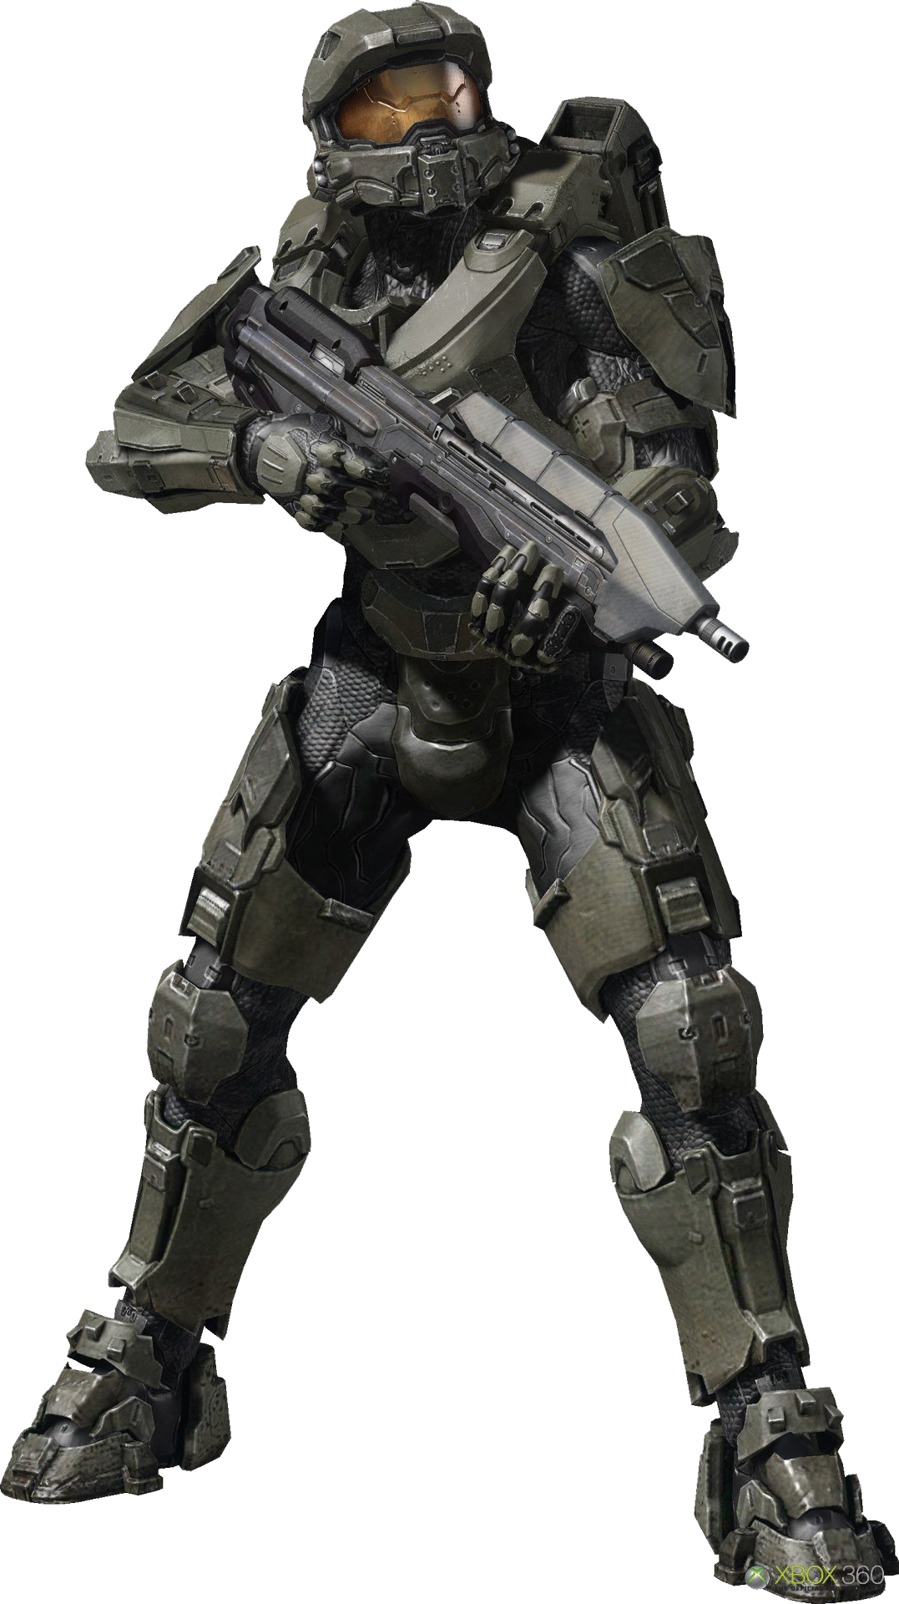
Variable exercise- Game Context
What variables does a player character have and of what data type?
Figure 5. Cutout of Master Chief from Halo
Note. From Halopedia (2025).

Slide 24
Variable exercise- Game Context
What variables does a player character have and of what data type?
Walk Speed - float
Jump Height - float
Health - int
Position - Vector
Weapons – Array*
Actions – Array*
Coins - int
Uniform Colour - Color
Etc...
Figure 5. Cutout of Master Chief from Halo
Note. From Halopedia (2025).
Notes:
Tell them arrays are more advanced and will be covered later. But could mention that they are a collection.

Slide 25
Coding Introduction
Functions

Slide 26
Functions
Functions add functionality to our games.
They modify the variables and other properties of our games.
Think of them like actions that are taken.

Slide 27
Function Exercise
What functions does a cat have?

Slide 28
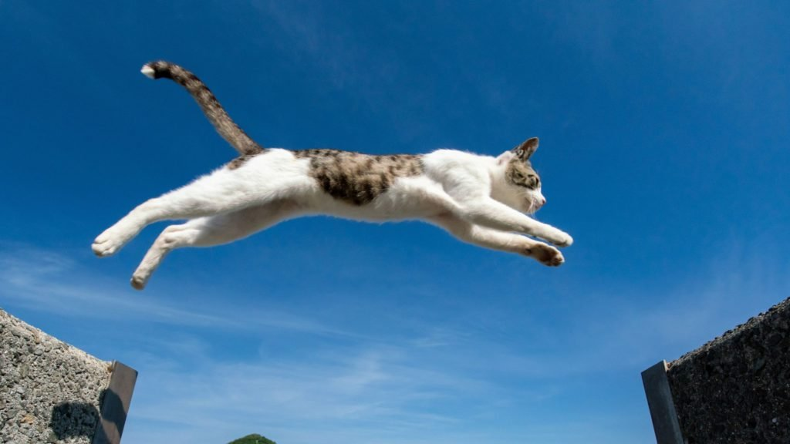


Function Exercise
What functions does a cat have?
Walk
Jump
Climb
Purr
Sleep
Stalk
Etc...
Figure 1.Sleeping Cat
Note. From Why Do Cats Sleep So Much? (2025), Britannica. https://www.britannica.com/story/why-do-cats-sleep-so-much
Figure 1 & 2.Cat jumping and cat climbing
Note. From How High Can Cats Jump? (2025), I'm a Pet Lover. https://imapetlover.com/how-high-can-cats-jump-understanding-their-aerial-prowess/

Slide 29
Function Exercise - Game Context
What functions does a player character have and what variable do they change?
Figure 5. Cutout of Master Chief from Halo
Note. From Halopedia (2025).

Slide 30
Function Exercise - Game Context
What functions does a player character have and what variable do they change?
Move
Update position variable * speed variable
Jump
Update y-position variable * jump height variable
Take Damage
Decrement the health variable by a value
Die
Play death animation, decrement lives, reset player to start
Shoot
Play fire animation, spawn bullet
Etc...
Figure 5. Cutout of Master Chief from Halo
Note. From Halopedia (2025).

Slide 31
Coding Introduction
Classes

Slide 32
Classes
Classes are the things that bind the variables and functions together.
Think of them like a blueprint used for the objects in your game.
Cat Class
Variables Name;
Age;
Breed;
Etc..
Functions
Run()
Jump()
Purr()
Etc..
Player Class
Variables Speed;
Jump Height;
Position;
Etc..
Functions
Move()
Jump()
Shoot()
Etc..

Slide 33
Classes
A game can contain many instances/copies of a class.
Each of these are treated as unique, meaning changing a variable in one copy only affects that copy and not the others, allowing us to have many variations of the class without having to create a new class each time.
This concept is known as OOP (Object Oriented Programming).
Cat Class
Variables Name = "Bob";
Age = 12;
Breed = "Tabby";
Etc..
Functions
.....
Cat Class
Variables Name = "Jane";
Age = 4;
Breed = "Persian";
Etc..
Functions
.....
Cat Class
Variables Name = "Sabrina";
Age = 6;
Breed = "Tabby";
Etc..
Functions
.....

Slide 34
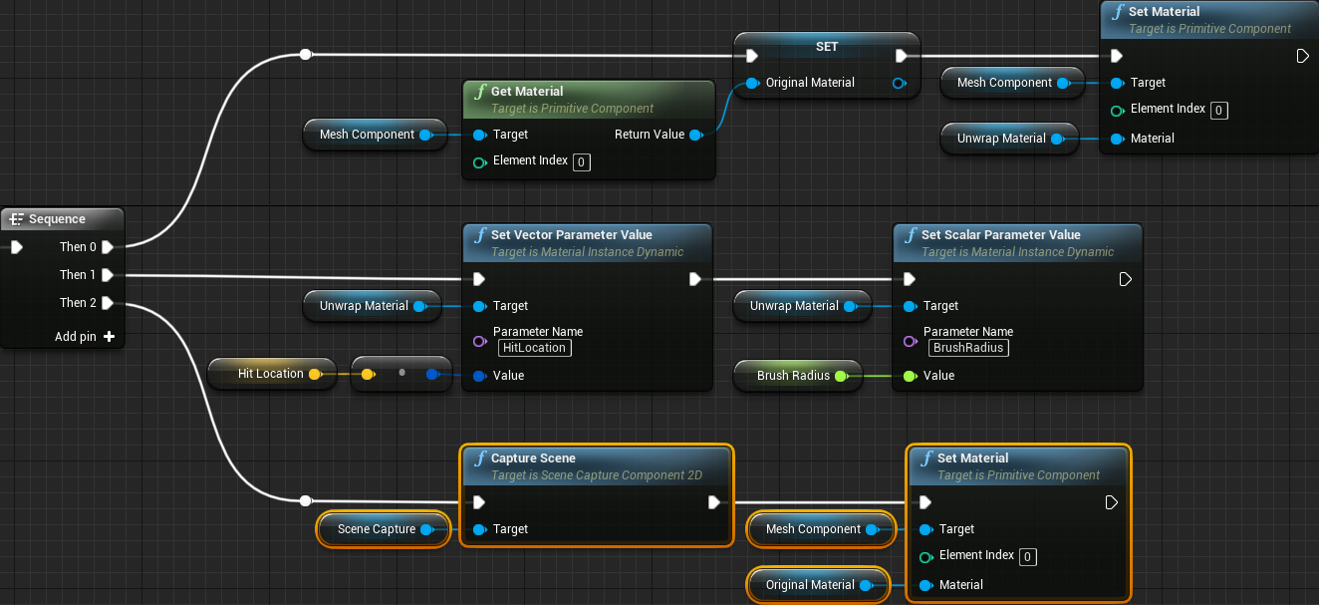
Classes
In Unreal Engine, we will be using its Blueprint system.
The Blueprint system is a visual way of representing a class, the variables and functions, and is often easier to pick up and understand than pure code.
It contains hundreds of nodes – small bits of functionality – that we connect to produce a desired outcome.

Slide 35
Coding Introduction
Logic/Pseudocode

Slide 36
Logic
The final step needed for it all to do what we hope, is to work out the logic.
I say hope as it often takes multiple attempts to get it working the way we expect it to.
This is understandable. Humans are not machines. We are smart. We can infer and draw conclusions based on context and knowledge. We can fill in the blanks.
Computers on the other hand are dumb*. They can follow instructions precisely but forget to be specific about something and you'll likely not get the answer you are after.
It is up to us to be as precise as we can when we ask the computer to do something then.
We have to solve the problem ourselves using Logic.
*Discuss modern AI and if it is really as smart as you think.

Slide 37
Pseudocode
Pseudocode is used to show how a computing algorithm should work.
Coders often use pseudocode as an intermediate step in programming in between the initial planning stage and the stage of writing actual executable code.
It is designed to be human readable and easy enough to understand.
It often resembles a series of short, precise instructions that do just a single thing.

Slide 38


Pseudocode Exercise
Write out the steps to make a cup of tea.

Slide 39
Pseudocode Exercise
Write out the steps to make a cup of tea.
Get Kettle
Fill the kettle with water from the tap
Turn on the kettle
Go to the cupboard
Open the cupboard
Get a cup out of the cupboard
Close the cupboard
Put the cup on the counter/table
Go to the pantry
Open the pantry
Get a tea bag from the pantry
Close the pantry
Place tea bag in the cup
Wait until water is boiled
When water has boiled
Get kettle and pour water into the cup with the tea bag
If sugar is desired
Get sugar from pantry
Get teaspoon from drawer
Put x amount of spoons full of sugar into the cup with the tea
Stir the contents of the cup
If milk is desired
Get milk from fridge
Pour x amount of milk into the cup with the tea
If sugar was added, use teaspoon to stir the milk in the cup
If sugar was not added,
get teaspoon from drawer
use teaspoon to stir the milk in the cup
Let the tea steep for 3-5 minutes
Remove the tea bag and discard it
Enjoy your cup of tea!
Phew!!!

Slide 40

Pseudocode Exercise
Now that is an extreme version of it, and there are still many little steps that were missed:
We never closed the fridge,
What if there were multiple choices of tea
We assumed the tea was in a teabag and not loose leaf
Etc...
But it does illustrate how much we infer upon our actions as humans.
Figure 1 Tea Meme
Note. 53 Funny Memes for Tea Lovers Everywhere (2025), Winkgo. 53 Funny Memes for Tea Lovers Everywhere

Slide 41
New Concepts
Expand your Unreal knowledge

Slide 42
Overview of New Content
Unreal Blueprints
Node based workflow examples
Setting up a basic material
Creating a Target that can be shot
Making the Target move
Giving the Target some Hit Points
Destroying the Target when its Hit Points reach 0
Particle Effects
Creating variations of the Target
Different move patterns
Different Hit Points
Different Colour Material Instances

Slide 43
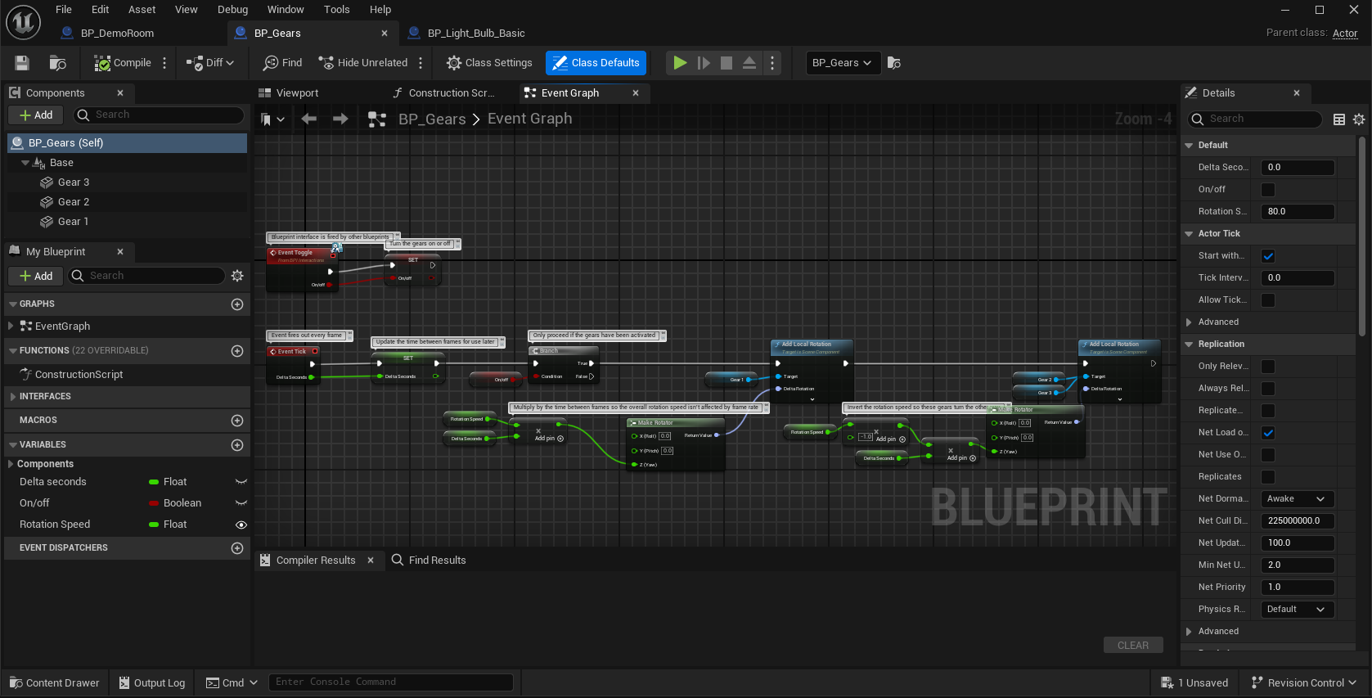
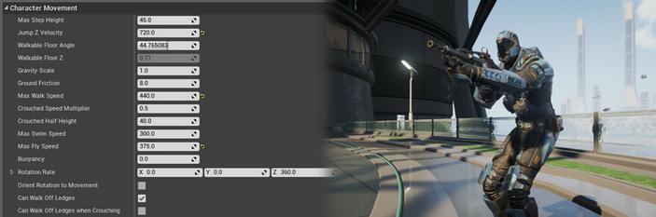
Unreal Blueprints
Unreal Blueprints is a visual scripting system in Unreal Engine that allows developers to create gameplay elements using a node-based interface.
This system provides designers with a wide range of scripting concepts and tools that are typically available only to programmers.
Blueprints can be used to define object-oriented classes or objects in the engine, and they are often referred to simply as "Blueprints".
Introduction to Blueprints Visual Scripting in Unreal Engine | Unreal Engine 5.6 Documentation | Epic Developer Community

Slide 44
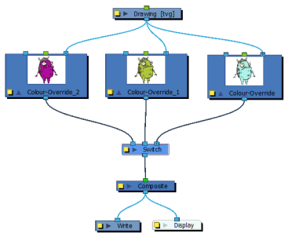
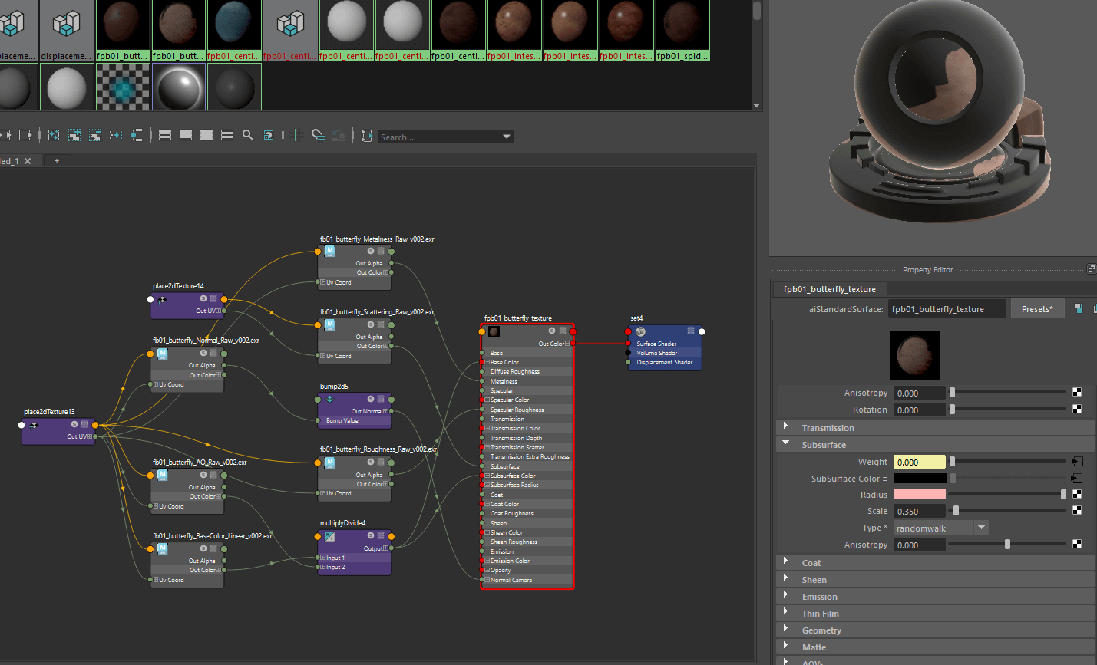
Node Based Workflows
Figure 1: Toon Boom Nodes
A node-based workflow is a method of organizing and managing tasks or processes where each task is represented as a node in a graph.
These nodes can be connected to show the flow of data or control between them, making it easier to visualize complex processes.
You will see it used in a variety of software you may encounter on your studies:
Maya Hypergraph
ToonBoom Harmony
Unity Shadergraph and Animator
Unreal Blueprints
Note. Developed by Toon Boom Animation Inc (2025). Inc. https://learn.toonboom.com/modules/combining-elements/topic/image-switch-node

Slide 45
Today's Tasks
What we will be doing

Slide 46
Tasks for Today
Download the starter project.
Setup the project on GitHub.
Push to GitHub.
a good practice to get into whenever you start a project.
Double click on the Unreal project file to open it.
Create a target practice game.
Follow along in the corresponding instructions document

Slide 47
Homework
Upgrade your skills

Slide 48
Expand your game
Complete and refine the in-class tasks.
Level Design: Build out your level to accommodate this action shooter style of gameplay.
Extra Mechanic: Add some of your own functionality / Expand upon the functionality we covered. Some examples:
Different colour particle explosions depending on the target hit.
Targets can move to more than two locations.
A timer where you must destroy all the targets before it runs out.
Documentation: Document your process and justify your choices. How do they add to the game? Remember to screenshot both new blueprints and level.
Remember Trial and Error is all part of the process. Don’t be afraid to try something new.
First try and pseudocode out your problem. It becomes much easier to solve once you have identified all the steps.
You may discover that everything is not going to work. Don't be disheartened, this is all part of the FUN!!!
Documenting both your successes and failures are invaluable and form part of your assessment task.

Slide 49
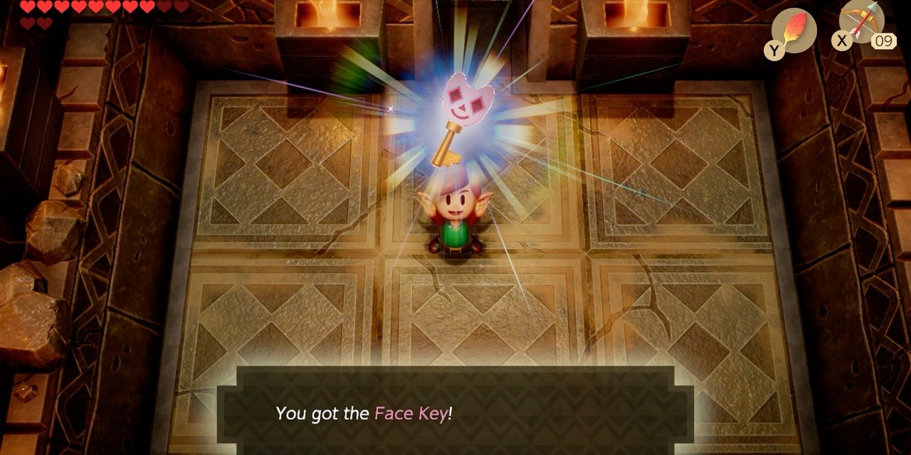
Next Week
Lock & Key mechanic analysis.
Lock & Key gameplay implementation.
Modeling in Unreal.
Colliders & Trigger Zones.
New Unreal nodes.

Slide 50
References
Valve Software, (2004). Haf Life 2 [Image]. Valve Software. Screenshot sourced from Steam https://store.steampowered.com/app/579840/Bloody_Trapland_2_Curiosity/
Bungie Software, (2004). Halo [Image]. Bungie Software. Screenshot sourced from Reddit https://www.reddit.com/r/HaloActionFigures/comments/wzzeyv/reclaimer/
Nintendo. (1997). Goldeneye. Rare Software

Slide 51
References
Figure 15.Bioshock Opening Level
Note. From What Bioshock Has Taught Me About Modern Game Design
, Game Spew (2016). https://www.gamespew.com/2016/10/bioshock-taught-modern-game-design/
Figure 5. Cutout of Master Chief from Halo. From Halopedia (2025). Halopedia. https://halo.fandom.com/es/wiki/Halopedia
Figure 4. Boxes of Variables. From Variables Programming (2021). Variables Programming. https://ar.inspiredpencil.com/pictures-2023/variables-programming
DIrectorName, Initial (Year). Descrition(italics?), company name, publisher name. URL
Figure 26.Knee High Barrier Meme
Note. From Nomads Review (2020). https://www.nomadsreviews.co.uk/post/top-eight-fps-tropes-that-hilariously-make-no-sense
Figure 27.Soldier carrying a lot of guns
Note. From Nomads Review (2020). https://www.nomadsreviews.co.uk/post/top-eight-fps-tropes-that-hilariously-make-no-sense
Figure 14.Bioshock Cover Art
Note. Bioshock Wiki (2025). https://bioshock.fandom.com/wiki/BioShock
Figure 16.Bioshock Little Sister Harvesting
Note. From Ludo Narrative Dissonance: What it Meant and What it Means, Pittsburgh University (2018). https://www.games.pitt.edu/ludonarrative-dissonance-what-it-meant-and-what-it-means/
Figure 20. Call of Duty Cover Collection
Note. From Section Plays (2024). https://www.youtube.com/watch?v=kjJZg9hmt4g
Figure 21.Call of Duty Modern Warfare II – Controversial No Russians Mission
Note. From Gameranx (2019). https://gameranx.com/updates/id/179706/article/infinity-ward-developer-reflects-on-controversial-no-russian-call-of-duty-modern-warfare-2-mission/
Figure 6. Goldeneye 007 N64 game cover
Note. From Wikipedia (2025). https://en.wikipedia.org/wiki/GoldenEye_007_(1997_video_game)
Figure 7. Goldeneye 007 Mission Briefing
Note. ModDB (2018). https://www.moddb.com/mods/project-goldeneye1/images/are-you-ready-to-get-back-to-work2
Figure 22.Sales chart of best-selling PlayStation games
Note. From Game Dev Reports (2025). https://gamedevreports.substack.com/p/circana-the-most-successful-projects
Figure 10. Unreal PC Cover
Note. From Wikipedia (2025). https://en.wikipedia.org/wiki/Unreal_(1998_video_game)
Figure 8. Goldeneye 007 Multiplayer
Note. From Inspired Pencil (2021). https://ar.inspiredpencil.com/pictures-2023/goldeneye-n64-multiplayer
Figure 9. Goldeneye 007
Note. From Super Adventures in Gaming (2012). https://superadventuresingaming.blogspot.com/2012/11/007-games-part-7-goldeneye-007-james.html
Figure 11. Unreal Tournament PC Cover
Note. From Wikipedia (2025). https://en.wikipedia.org/wiki/Unreal_Tournament
Figure 12Unreal In Game Image
Note. From Moby Games (2016). https://www.mobygames.com/game/330/unreal/promo/group-9985/image-115316/
Figure 1. Doom PC Cover
Note. From DoomWiki (2025). https://doomwiki.org/wiki/File:Doom.jpg
Figure 2. Doom E2M6 Halls of the Damned
Note. From DoomWiki (2025). https://doomwiki.org/wiki/File:Doom-e2m6-room2.png
Figure 13. Unreal Tournament In Game Image
Note. From The King of Grabs (2023). https://thekingofgrabs.com/2023/02/02/unreal-tournament-pc/
Figure 2. Doom E2M6 Final Ambush
Note. From DoomWiki (2025). https://doomwiki.org/wiki/File:Doom-e2m6-final-ambush.png

